Slide 1

Benefits, Models, and Shared Responsibility
Introduction to Cloud Computing

Slide 2
Lecture Objectives
Understand what Cloud is and what Cloud Computing entails. Understand the benefits of Cloud Computing.
Differentiate between CapEx and OpEx.
Explore cloud service models (IaaS, PaaS, SaaS).
Comprehend the shared responsibility model.

Slide 3

Cloud and Cloud Computing
The Cloud refers to a network of servers accessed over the internet that provide various services like storage, computing power, and applications.

Slide 4
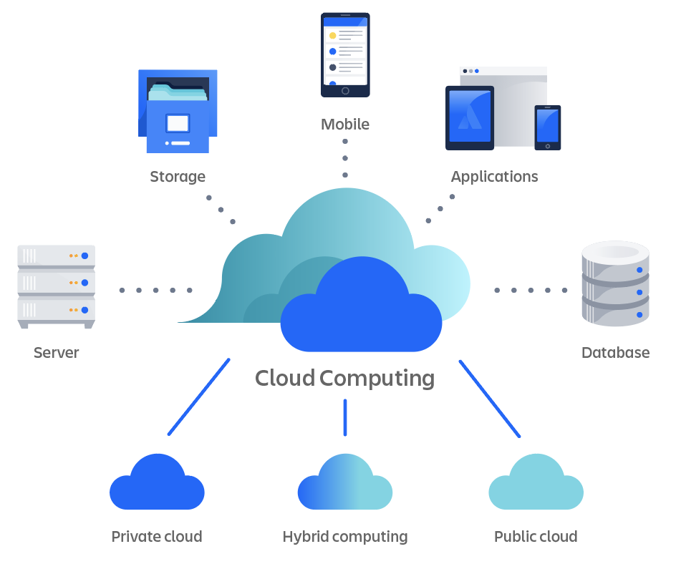
Cloud and Cloud Computing
Cloud Computing is the delivery of these services on-demand, allowing users to access resources without owning physical infrastructure.
Key features include scalability, flexibility, cost-efficiency, and accessibility from anywhere.

Slide 5
Benefits of Cloud Computing
High Availability: Systems are operational and accessible most of the time.
Scalability: Easily scale resources up or down based on demand.
Elasticity: Automatically adjusts resources to match workloads.
Agility: Rapid deployment and innovation

Slide 6
CapEx vs OpEx
Capital Expenditure (CapEx):
Upfront costs for physical hardware and infrastructure.
Long-term investment with depreciation over time.
Operational Expenditure (OpEx):
Pay-as-you-go model for cloud resources.
Immediate cost based on usage, reducing upfront investment.

Slide 7
Cloud Service Models
1. Infrastructure as a Service (IaaS):
Provides virtualized computing resources.
Example: AWS EC2, Azure Virtual Machines.
2. Platform as a Service (PaaS):
Platform for app development and deployment.
Example: Google App Engine, Azure App Services.
3. Software as a Service (SaaS):
Delivers software over the internet. Users connect to and use cloud-based apps over the internet.
Example: Microsoft 365, Salesforce.

Slide 8
Shared Responsibility Model
Cloud Provider:
Responsible for securing physical infrastructure, network, and hardware.
Customer:
Responsible for data, user access, and configurations within the cloud.
This shared approach ensures comprehensive security and operational efficiency.

Slide 9
Cloud Computing in Action
Netflix:
Utilizes AWS for scalability during peak streaming times.
Slack:
Runs on cloud infrastructure to ensure uptime and collaboration.
Dropbox:
Provides SaaS for file storage and sharing.

Slide 10
Scalability and Elasticity
Scalability:
Increase or decrease resources as needed to meet user demands.
Elasticity:
Automatic adjustment of resources to optimize cost and performance.

Slide 11
Disaster Recovery
Cloud services provide backup and restore capabilities.
Data is stored across multiple geographic locations for redundancy.
Ensures minimal downtime and data loss during catastrophic events.
Notes:
Disaster Recovery And Business Continuity

Slide 12
Security Enhancements
Cloud providers offer robust security measures:
Data encryption, identity management, and access control.
Regular security updates ensure protection against evolving threats.

Slide 13
Conclusion
Cloud computing offers benefits like scalability, high availability, and agility.
CapEx involves upfront investments, while OpEx reduces entry barriers.
IaaS, PaaS, and SaaS cater to various user needs with differing responsibilities.
The shared responsibility model ensures a collaborative approach to cloud security.

Slide 14
Questions?

